Slide 1
UNIT-1
CHAPTER-2

Slide 2
Introduction To UML
The Unified Modeling Language (UML) is a standard language for writing software blue prints.
The UML is appropriate for modeling systems ranging from enterprise information systems to distributed web-based applications and even real time embedded systems.
The UML is process independent.

Slide 3
The UML is a language for
1) Visualizing
2) Specifying
3) Constructing
4) Documenting

Slide 4
The UML is a Language.
What is a Language?
What is a modeling language?

Slide 5
A modeling language is a language whose vocabulary and rules focus on the conceptual and physical representation of a system.
Modeling yields an understanding of a system.

Slide 6
UML is a language for visualizing
Text is a wonderful minimal and direct way to write expressions and algorithms.
In such cases, the programmer is still doing modeling.
Why?

Slide 7
There are several problems with this
Communicating the conceptual models to others is error-prone unless everyone involved speaks the same language.
2) There are some things about a software system you can’t understand unless you build models that transcend the textual programming language.
(Example : Class hierarchy)

Slide 8
3) If the developer who cut the code never wrote down the models that are in his or her head, that information would be lost forever or, at best, only partially recreatable from the implementation, once that developer moved on.

Slide 9
UML is a language for Specifying
Specifying means building models that are precise, unambiguous and complete.
The UML addresses the specification of all the important analysis, design and implementation decisions that must be made in developing and deploying a software system.

Slide 10
UML is a language for Constructing
The UML is not a visual programming language, but its models can be directly connected to a variety of programming languages, such as JAVA, C++ or Visual Basic or even to Tables of database.
Forward Engineering
Reverse Engineering

Slide 11
UML is a language for Documenting
A software organization produces all sorts of artifacts in addition to row executable code. The artifacts including the following:
-Requirements -Project Plan
-Architecture -Tests
-Design -Prototypes
-Source Code -Releases.

Slide 12
UML Application Areas
The UML is intended primarily for Software intensive systems. It has been used effectively for such domains as follows:
Enterprise information systems
Banking and financial services
Telecommunications
Transportation
Defense
Medical , Electronics, scientific and Distributed web-based services.

Slide 13
A Conceptual Model of the UML
To understand the UML, a conceptual model of the language is need to form and it requires the three major elements:
Building blocks of the UML.
Rules that dictate how these building blocks may be put together.
Common mechanisms that apply throughout the UML.

Slide 14
1. Building blocks of the UML
The UML consists of three kinds of building blocks:
Things- These are the abstractions that are first-class citizens in a model.
Relationships-Tie the above things together.
Diagrams-Group interesting collections of things,

Slide 15
Building Blocks of UML
Things
Relationships
Diagrams
Class, Interface,
Active class, Use case,
Component,
Collaboration, Node
Structural
Dependency,
Generalization,
Associations,
Realization
Use case,
Class,
Object,
Sequence,
Collaboration,
State chart,
Activity,
Component,
Deployment.
Behavioral
Interaction,
State Machine
Grouping
Package
Annotational
Note

Slide 16
Things in the UML
There are 4 kinds of things in the UML
Structural Things
Behavioral Things
Grouping Things
Annotational Things

Slide 17
1. Structural Things
Structural things are the nouns of UML models. These are mostly static parts of a model, representing elements that are either conceptual or physical.
There are 7 kinds of Structural things:
Class
Interface
Collaboration
Use case
Active class
Component
Node

Slide 18
Class:-
A class is a description of a set of objects that share the same attributes, operations, relationships and semantics.
A class implements one or more interfaces.
Window
Origin Size
Open( ) Close( ) Move( ) Display( )
Name
Attributes
class
Operation

Slide 19
(2) Interface:-
Interface is a collection of operations that specify a service of a class or component.
An interface describes the externally visible behavior of that element.

Slide 20
An interface defines a set of operation specifications but never a set of operation implementations.
Graphically, an interface is represented as a circle with its name.
ISpelling
Interface

Slide 21
(3) Collaboration:-
A collaboration defines an interaction and is a society of roles and other elements that work together to provide some cooperative behavior.
Therefore, collaboration have structural as well as behavioral dimensions.
Graphically a collaboration is represented as an ellipse with dashed lines, usually including only its name.

Slide 22
(4) Use case:-
A Use case is a description of set of sequence of actions that a system performs, which results a value to a particular actor.
A use case is used to structure the behavioral things in a model.

Slide 23
A use case is realized by a collaboration.
Withdraw money
Use case

Slide 24
The remaining three things- Active classes, components and nodes- all are class like, ie., they also describe a set of objects that share the same attributes, operations, relationships and semantics.

Slide 25
(5) Active class:-
An active class is a class whose objects own one or more processes or threads and therefore can initiate control activity.
Active Class initiate and control the flow of activity, while passive classes store data and serve other classes.
We illustrate active classes with a thicker border.

Slide 26
Graphically, an active class is represented like a class, but with heavy lines, usually including its name, attributes and operations.
Event manager
Suspend() Flush()
Active class

Slide 27
The remaining two elements –component and nodes- they represent physical things, where as previous five things ( class, interface, collaboration, usecase, active class) represent conceptual or logical things.

Slide 28
(6) Component:-
A component is a physical and replaceable part of a system that conforms to and provides the realization of a set of interfaces.
A component represents the physical packaging of logical elements such as classes, interfaces and collaborations.

Slide 29
orderform.java
Component

Slide 30
(7) Node:-
A node is physical element that exists at run-time and represents a computational resource, generally having some memory and processing capability.
A set of components may reside on a node and may also migrate from node to node.

Slide 31
Database server
Node

Slide 32
2. Behavioral Things
These are the dynamic parts of UML models.
These are the verbs of a model representing the behavior over time and space.
There are two types of behavioral things
1. Interaction
2. State machine.

Slide 33
Interaction:-
An Interaction is a behavior that comprises a set of messages exchanged among a set of objects within a particular context to perform a specific purpose.
display
display
Message

Slide 34
An interaction involves a number of other elements, including messages, action sequences and links. (connection between objects.)

Slide 35
2. State machine:-
A State machine is a behavior that specifies the sequences of states an object or an interaction goes through during its lifetime in response to events, together with its responses to those events.
waiting
State

Slide 36
A State machine involves a number of other elements, including states, transitions( the flow from state to state), events (things that trigger a transition), and activities ( the response to a transition).

Slide 37
3. Grouping Things
Grouping things are the organizational parts of UML models.
In all, there is one primary kind of grouping thing, namely, Package.
Package:- A Package is a general-purpose mechanism for organizing elements into groups.

Slide 38
Structural things, behavioral things and even other grouping things that may be placed in a package.
Unlike component (which exist at run time), package is purely conceptual (meaning that it exist only at development time).

Slide 39
Business rules
Package

Slide 40
4. Annotational Things
Annotational Things are the explanatory parts of the UML models.
These are the comments you may apply to describe, illuminate and remark about any element in a model.
There is one primary kind of Annotational thing, called a Note.

Slide 41
Note:- A Note is simply a symbol for representing constraints and comments attached to an element or a collection of elements.
A note is rendered as a rectangle with a
dog-eared corner.
Return copy of self
Note

Slide 42
2. Relationships in the UML
There are four kinds of relationships in the UML.
1. Dependency
2. Association
3. Generalization
4. Realization
These relationships are the basic relational building blocks of the UML. These are used to write well-formed models.

Slide 43
DEPENDENCY:-
A Dependency is a semantic relationship between two things in which a change to one thing( the independent thing) may affect the semantics of the other thing (the dependent thing).
Dependencies

Slide 44
ASSOCIATION:-
An Association is a structural relationship that describes a set of links, a link being a connecting among objects.
Aggregation is a special kind of association, representing a structural between a whole and its parts.

Slide 45
An association is represented as a solid line, possibly directed, occasionally including a label, and often containing other adornments, such as multiplicity and role names.
0..1
*
employer
employee
Association

Slide 46
GENERALIZATION:-
A generalization is a specialization/generalization relationship in which objects of the specialized elements (the child) are substitutable for objects of the generalized elements (the parent).
In this way, the child shares the structure and the behavior of the parent.
Represented as a solid line with a hollow arrow head pointing to the parent.
Generalization

Slide 47
REALIZATION:-
A realization is a semantic relationship between classifiers, wherein one classifier specifies a contract that another classifier guarantees to carryout.
We will encounter realization relationships in two places: between interfaces and classes or components that realize them, and between use cases and the collaborations that realize them.
Realization

Slide 48
3. Diagrams in the UML
A diagram is the graphically presentation of a set of elements, most often represented as a connected graph of vertices (things) and arcs (relationships).
Diagrams visualize a system from different perspectives, so a diagram is a projection into system.

Slide 49
The UML includes nine diagrams:
Class diagram
Object diagram
Use case diagram
Sequence diagram
Collaboration diagram
State chart diagram
Activity diagram
Component diagram
Deployment diagram

Slide 50
1. Class Diagram
A class diagram shows a set of classes, interfaces, and collaborations and their relationships.
These diagrams are the most common diagrams found in modeling object-oriented systems.
Class diagram address the static design view of a system.

Slide 51
2. Object Diagram
An object diagram shows a set of objects and their relationships.
Object diagrams represent static snapshots of instances of the things found in class diagram.

Slide 52
3. UseCase Diagram
Use case diagram shows a set of use case and actors (a special kind of class) and their relationships.
Use case diagrams address the static use case view of a system.
These diagrams are especially important in organizing and modeling the behaviors of a system

Slide 53
(4) & (5) Sequence and Collaboration diagrams
Both sequence diagrams and collaboration diagrams are kind of interaction diagrams.
An interaction diagram shows an interaction, consisting of a set of objects and their relationships, including the messages that may be dispatched among them.
Interaction diagram address the dynamic view of a system.

Slide 54
A sequence diagram is an interaction diagram that emphasizes the time ordering of messages.
A collaboration diagram is an interaction diagram that emphasizes the structural organization of the objects that send and receive messages.
Sequence diagrams and collaboration diagrams are isomorphic, meaning that you take one and transform it into the other.

Slide 55
6. State Chart Diagram
A statechart diagram shows a state machine, consisting of states, transitions, events and activities.
Statechart diagram address the dynamic view of a system.

Slide 56
7. Activity Diagram
An activity diagram is a special kind of a statechart diagram that shows the flow from activity to activity within a system.
Activity diagram address the dynamic view of a system.

Slide 57
8. Component Diagram
A component diagram shows the organizations and dependencies among a set of components.
Component diagram address the static implementation view of a system.

Slide 58
9. Deployment Diagram
A deployment diagram shows the configuration of run-time processing nodes and the components that live on them.
Deployment diagram address the static deployment view of an architecture.

Slide 59
2. Rules of the UML:-
The UML’s building blocks cant simply be thrown together in a random fashion.
Like any language, the UML has a number of rules that specify what a well-formed model should look like.

Slide 60
The UML has semantic rules for:-
Names- What you can call things, relationships and diagrams.
Scope- The context that gives specific meaning to a name.
Visibility- How those names can be seen and used by others.
Integrity- How things properly and consistently relate to one another.
Execution- What it means to run or simulate a dynamic model.

Slide 61
3.Common Mechanisms
The 4 common mechanisms that apply consistently throughout the language.
Specifications
Adornments
Common Divisions
Extensibility mechanisms

Slide 62
Specifications:-
The UML is more than just a graphical language. Rather, behind every part of graphical notation there is a specification that provides a textual statement of the syntax and semantics of that building block.
For example, behind a class icon is a specification that provides the full set of attributes, operations and behaviors.
You use the UML’s graphical notation to visualize a system; you use the UML’s specification to state the system details.

Slide 63
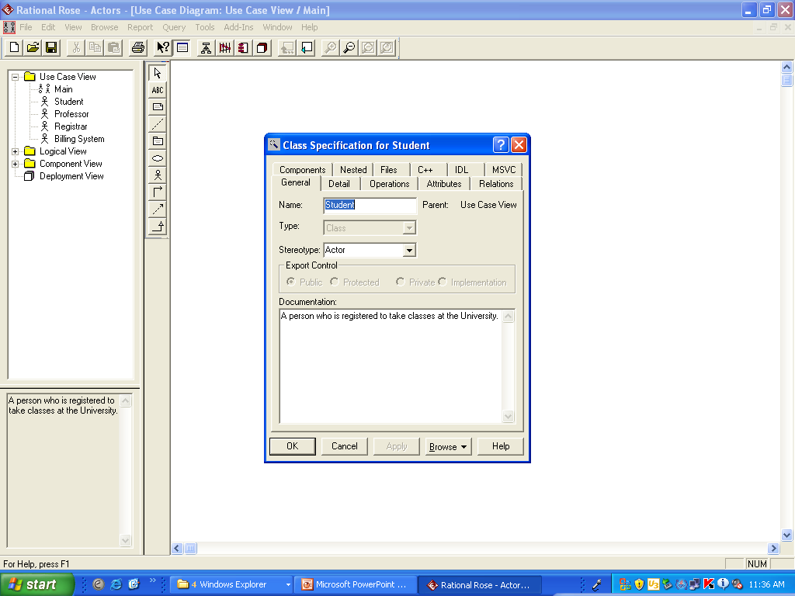
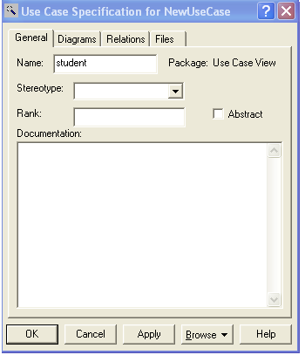

Slide 64
2. Adornments:-
Adornments Textual/graphical items added to the basic notation of an element.
Used for visualizing details from the element’s specification
Example: The basic notation of association is a line, but this could be adorned with additional details, such as the role and multiplicity of each end.
The most important kind of adornments are notes.
0..1
*
Employer
Employee

Slide 65
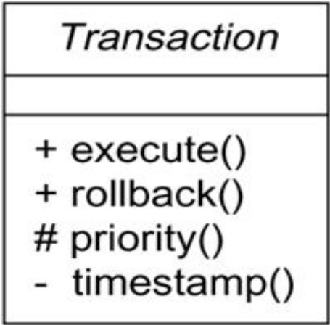

Slide 66
3.Common Divisions
Abstraction vs. manifestation
Class vs. object
Most UML building blocks have this kind of class/object distinction.
Interface vs. implementation
An interface declares a contract, and an implementation represents one concrete realization of that contract.

Slide 67
Customer
name address phone
Jan :Customer
:Customer
Elyse
Classes and Objects

Slide 68
SpellingWizard.dll
IUnknown
ISpelling
Interfaces and Implementations

Slide 69
4.Extensibility Mechanisms
Allows you to extend the language by adding new building blocks, creating new properties and specifying new semantics. Includes:
Stereotypes
Tagged values
Constraints

Slide 70
Stereotypes
Extend the vocabulary of the UML by creating new model elements derived from existing ones but that have specific properties suitable for your domain/problem.

Slide 71
Stereotype
EventQueue
{version =3.2
Author=egb }
Tagged value
<< Exception>>
Overflow
add( )
remove( )
flush( )
{ordered}
Constraints
Extensibility Mechanisms

Slide 72
Example: In Java, you sometimes have to model
classes such as exceptions.
Only want them to be thrown and caught
Can make them first class citizens in your model, ie treating them like basic building blocks, by marking them with a suitable stereotype.

Slide 73
Graphically, a stereotype is rendered as a name enclosed by guillemots and placed above the name of another element (eg, <<name>>)
Alternatively, you can render the stereotyped element by using a new icon associated with that stereotype

Slide 74
Named stereotype
Named stereotype with icon
Stereotyped element as icon
<<metaclass>>
Model Element
<<exceptions>>
Underflow !
HumiditySensor

Slide 75
2.Tagged values:-
Properties for specifying key-value pairs of model elements, where
keywords are attributes.
Extend the properties of a UML building block, allowing you to
create new information in that elements specification.
Can be defined for existing elements of the UML

Slide 76
Stereotype
EventQueue
{version =3.2
Author=egb }
Tagged value
<< Exception>>
Overflow
add( )
remove( )
flush( )
{ordered}
Constraints
Extensibility Mechanisms

Slide 77
3.Constraints:-
Properties for specifying semantics or conditions that must be maintained as true for model elements.
Extend the semantics of a UML building block, allowing you to add new rules, or modify existing ones.
Example:- you might want to constrain the EventQueue class so that all additions are done in order.

Slide 78
Stereotype
EventQueue
{version =3.2
Author=egb }
Tagged value
<< Exception>>
Overflow
add( )
remove( )
flush( )
{ordered}
Constraints
Extensibility Mechanisms

Slide 79
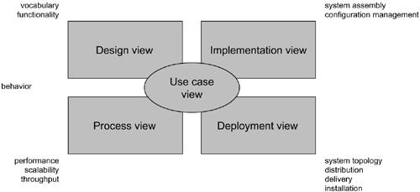
Architecture
Modeling a System's Architecture

Slide 80
Use case view
The use case view of a system includes the use cases that describe the behavior of the system as seen by its end users, analysts, and testers.
This view doesn’t specify the organization of a software system. Rather, it Specify the shape of the system's architecture.
The static aspects of this view are captured in use case diagrams;
and the dynamic aspects of this view are captured in interaction
diagrams, statechart diagrams, and activity diagrams.

Slide 81
Design view
The design view of a system includes the classes, interfaces, and collaborations that form the vocabulary of the problem and its solution.
This view primarily supports the functional requirements of the system, meaning the services that the system should provide to its end users.
The static aspects of this view are captured in class diagrams and object diagrams and the dynamic aspects of this view are captured in interaction diagrams, statechart diagrams, and activity diagrams.

Slide 82
Process view
The process view of a system includes the threads and processes that form the system's concurrency and synchronization mechanisms.
This view primarily addresses the performance, scalability, and throughput of the system.
The static and dynamic aspects of this view are captured in the same kinds of diagrams as for the design view, but with a focus on the active classes that represent these threads and processes.

Slide 83
Implementation view
The implementation view of a system includes the components and files that are used to assemble and release the physical system.
This view primarily addresses the configuration management of the system's releases, made up of somewhat independent components and files that can be assembled in various ways to produce a running system.
The static aspects of this view are captured in component diagrams; the dynamic aspects of this view are captured in interaction diagrams, statechart diagrams, and activity diagrams.

Slide 84
Deployment view
The deployment view of a system includes the nodes that form the system's hardware topology on which the system executes.
This view primarily addresses the distribution, delivery, and installation of the parts that make up the physical system.
The static aspects of this view are captured in deployment diagrams; the dynamic aspects of this view are captured in interaction diagrams, statechart diagrams, and activity diagrams.

Slide 85
S/w Development Life cycle
The UML is largely process-independent, meaning that it is not tied to any particular software development life cycle.
However, to get the most benefit from the UML, you should consider a process that is
Use case driven
Architecture-centric
Iterative and incremental

Slide 86
Use case driven means that use cases are used as a primary artifact for establishing the desired behavior of the system, for verifying and validating the system's architecture, testing, communicating among the stakeholders of the project.
Architecture-centric means that a system's architecture is used as a primary artifact for conceptualizing, constructing, managing, and evolving the system under development.
An iterative process is one that involves managing a stream of executable releases. It involves the continuous integration of the system's architecture to produce these releases, with each new release embodying incremental improvements over the other.

Slide 87
Together, an iterative and incremental process is risk-driven, meaning that each new release is focused on attacking and reducing the most significant risks to the success of the project.
This use case driven, architecture-centric, and iterative/incremental process can be broken into phases.
A phase is the span of time between two major milestones of the process, when a well defined set of objectives are met, artifacts are completed, and decisions are made whether to move into the next phase.

Slide 88
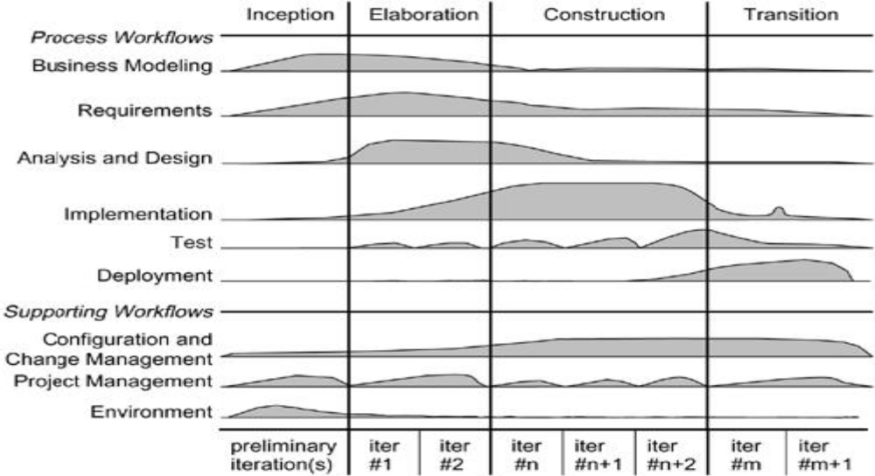
There are four phases in the software development life cycle: inception, elaboration, construction, and transition.

Slide 89
Inception is the first phase of the process, the basic idea for the development.
Elaboration is the second phase of the process, the product vision and its architecture are defined.
Construction is the third phase of the process, the software is brought from an executable architectural baseline to being ready to be transitioned to the user community.
Transition is the fourth phase of the process, when the software is turned into the hands of the user community.

